Slide 1
Museum of Discovery & Science To Fly
Sarah Valme – User Interface
Dario Loriato – Graphics
Kevin Deng – Java Programming
Summer 2015

Slide 2
Objective
Create a mobile application that assists in the education of the To Fly exhibit (aviation, aerodynamics, etc).

Slide 3
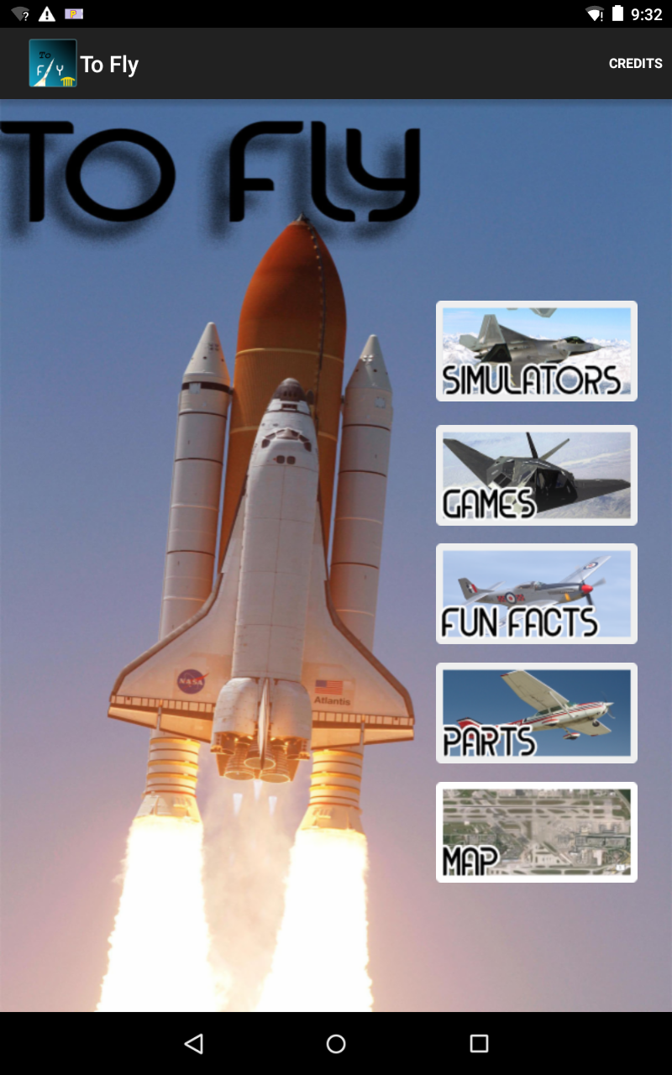
To Fly - Overview
Five main categories:
Simulators
Games
Fun Facts
Plane Parts
Map

Slide 4
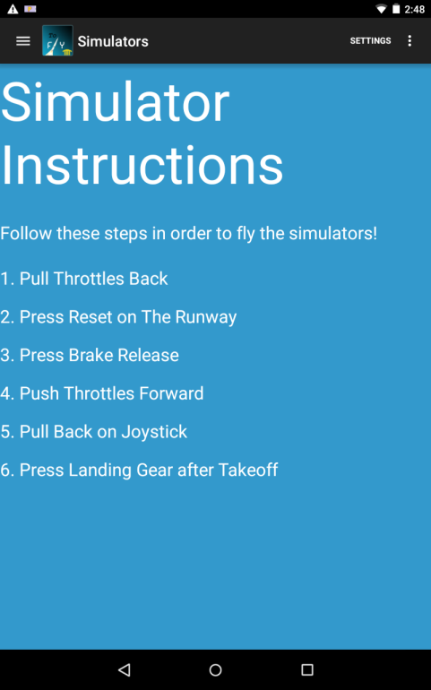
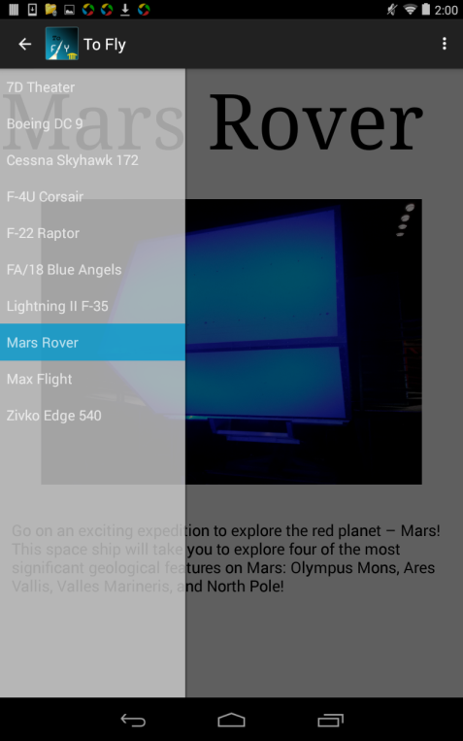
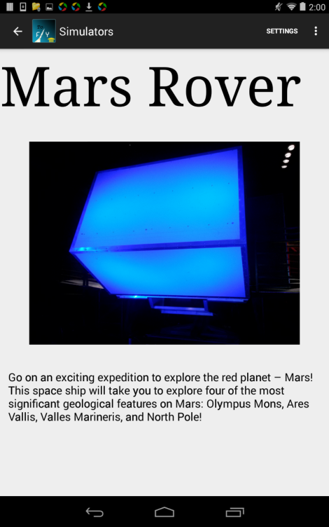
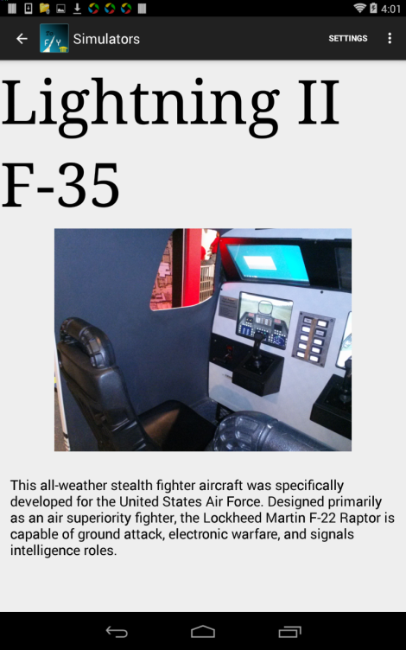
Simulators
Flight instructions
Image of simulator; Details of the history and features of each unique aircraft
Gives more information on To Fly featured attractions, such as MaxFlight and 7D Theater

Slide 5
Games
Trivia Game:
10 Questions, multiple choice
Correct/Incorrect message is displayed after each question
Answers with explanation/additional info shown at end of quiz
Scavenger Hunt:
Not completed; for future development

Slide 6
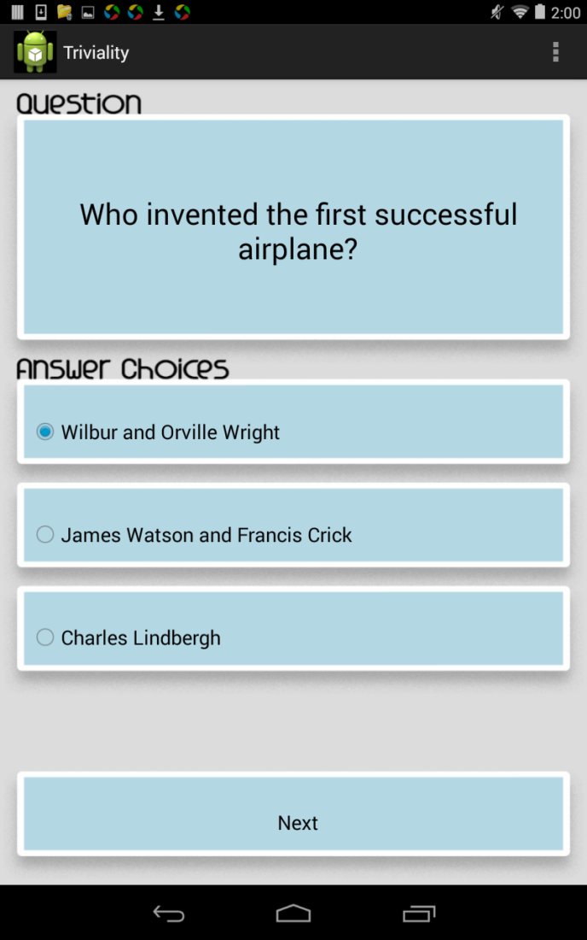
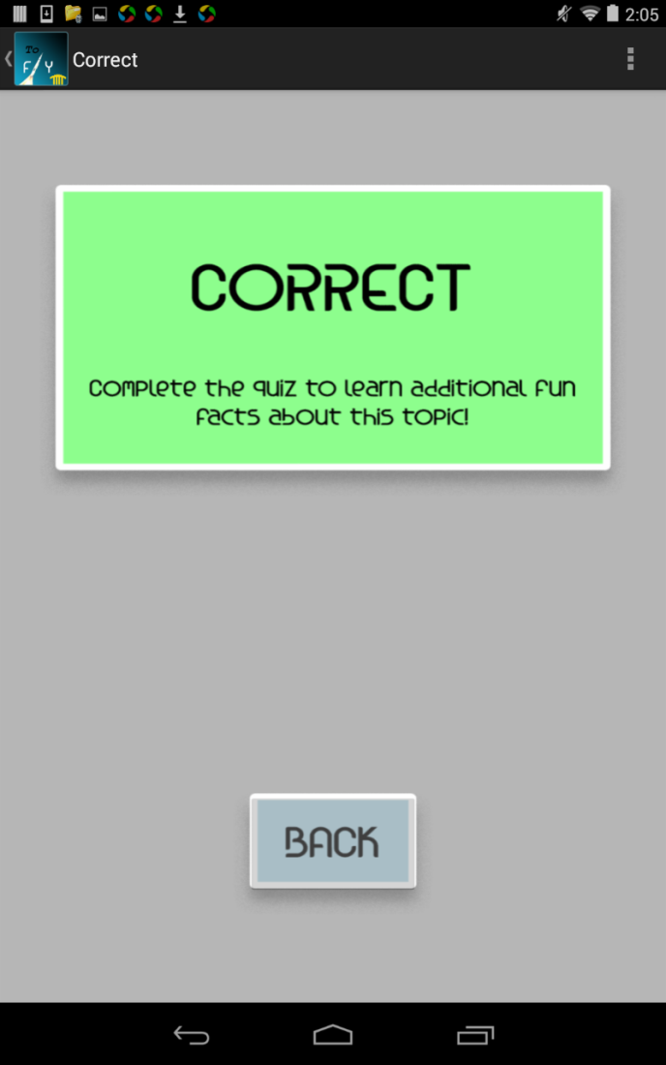
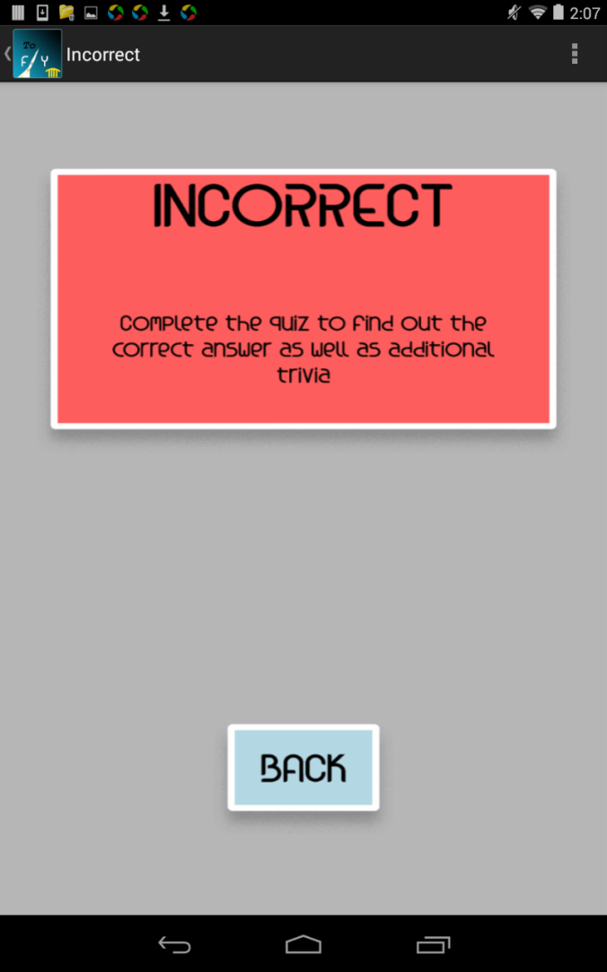

Slide 7
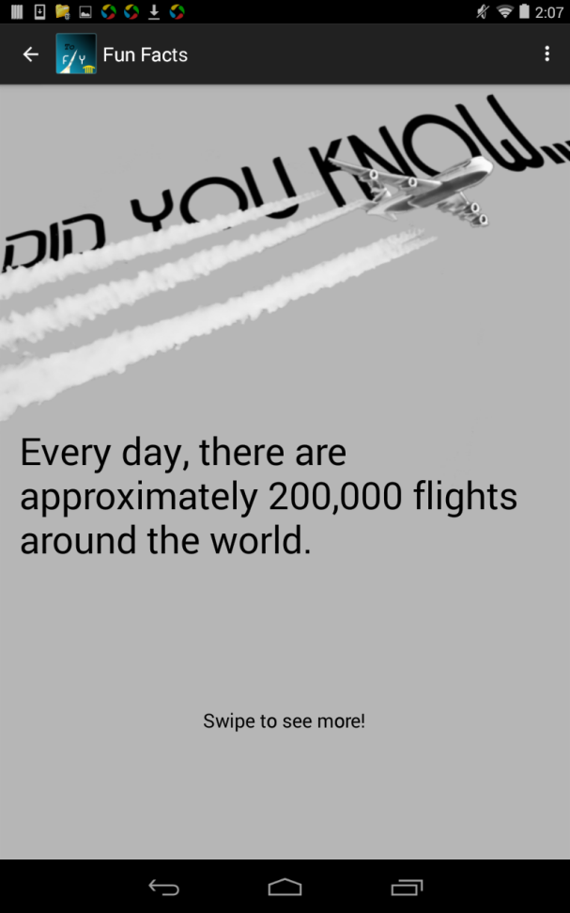
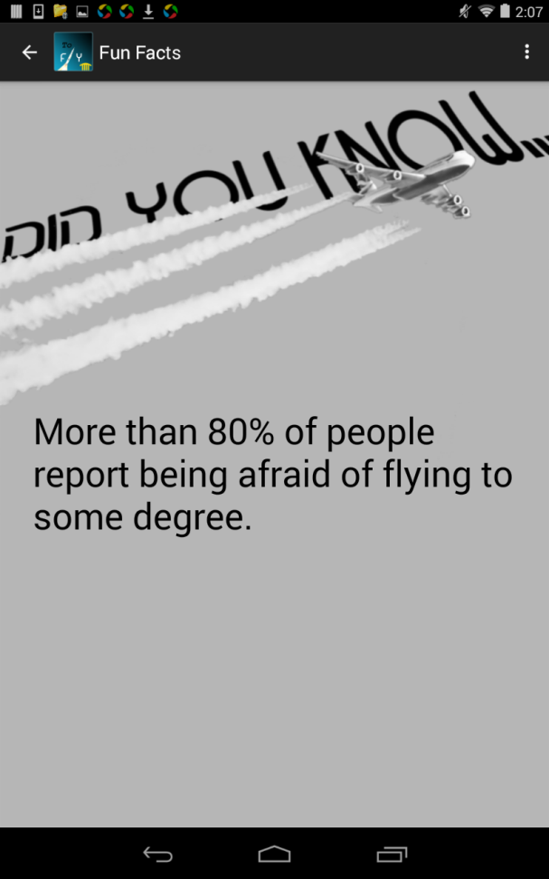
Fun Facts
Swipe View
10 Interesting “Did You Know” Fun Facts

Slide 8
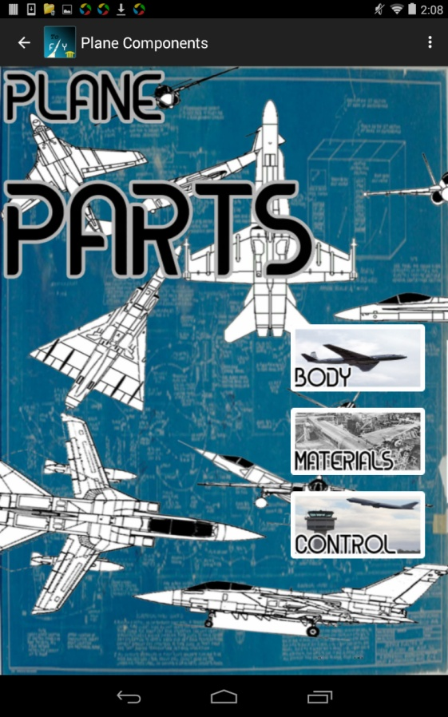
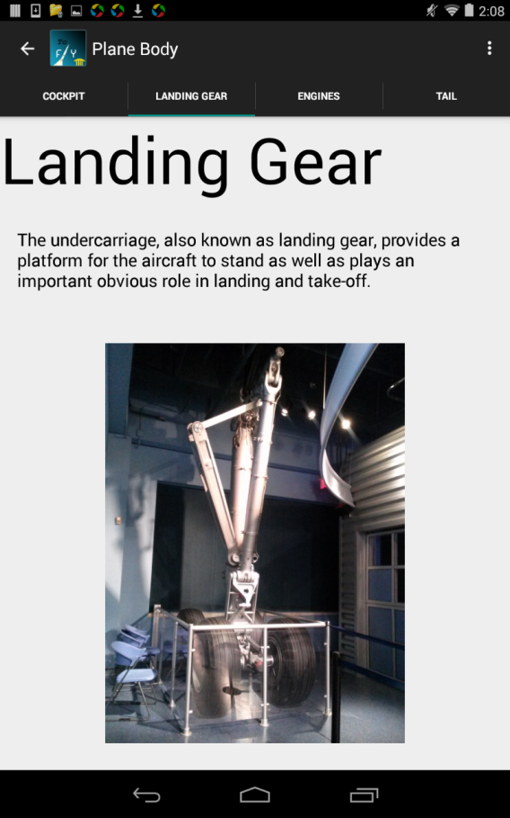
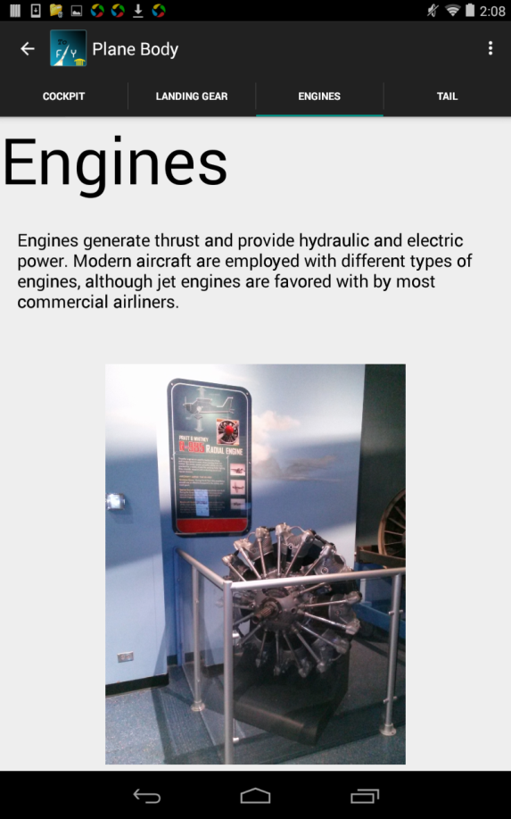
Plane Parts
Image and function of parts of a plane
Different types of materials used
Control Tower image and function

Slide 9
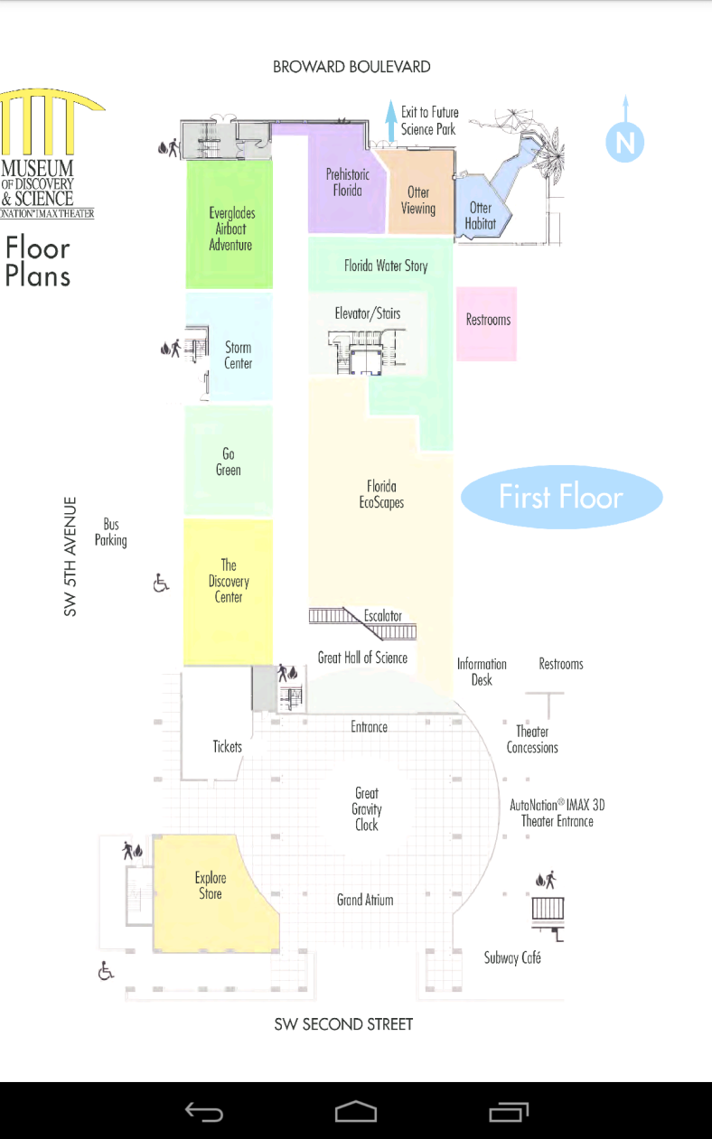
Map

Slide 10
Android Studio Code – Main Classes
main.java
Displays main screen with buttons
Loads new activity for Simulators, Fun Facts, and Parts
Uses Broadcast Intent and Receiver
QuizActivity.java, DbHelper.java
Uses SQLiteDatabase to store questions/answers
QuizActivity creates DbHelper object to retrieve questions
MyBroadCastReceiver.java
Implemented in Trivia Game and MODS Map
Main menu sends intent, game/map receives it, game/map loads

Slide 11
User Interface
Navigation drawer – easy to navigate through simulators with title, picture, information
Fun Facts Swipe View – Simple, user friendly for visitors
Plane Parts – Swipe view with tabs for clear presentation of information
Credits – Animation file

Slide 12
Graphics
Mostly used Photoshop
Consistent Kosova font throughout app
Buttons – White border for contrast
Simple Quiz layout graphics
Plane Parts blueprint background – gives “engineer” feeling

Slide 13
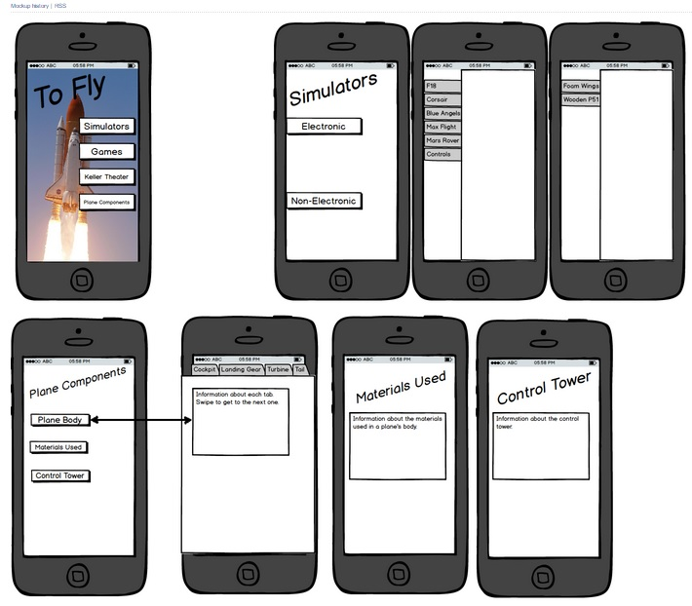

Slide 14
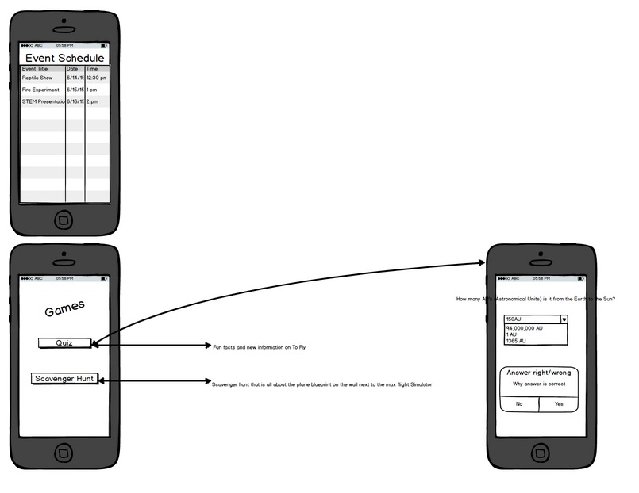

Slide 15
Thank You!!!
FAU Staff –Dr. Shankar, Professor McAfee, Santiago Aguerrevere, Demetrius Dukes, Alain Edwards, Dr. Mitsova-Boneva
Museum of Discovery & Science – Summer Scarlatelli, Joe Cytacki
United Way of Broward County
Hallandale High School, Cypress Bay High School
Sudoku game app, Trivia game app, MODS Explorer app

Slide 16

Questions?

